Slide 1


Where Are You Going, Where Have You Been?

Slide 2
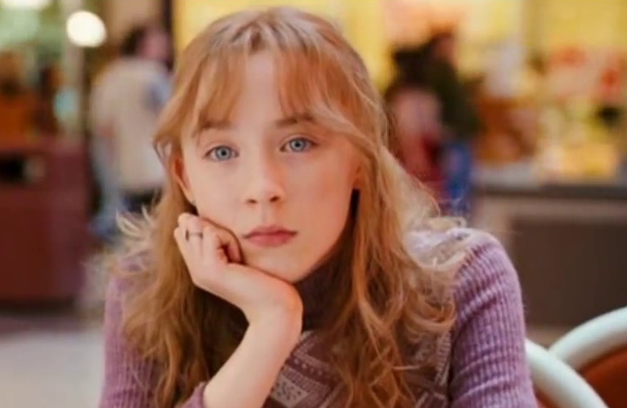
Introduction
A comprehensive info graphic on the five elements of the five elements of the plot.
The characters in the story are;
Connie
Cornnie’s mother
June (Connie’s elder sister)
Eddie

Slide 3
Rising action
In “Where Are You Going, Where Have You Been?” Joyce Carol narrates about the life of a young teenage girl named Connie.
As a young girl, Connie is compared to her sister June, because her mother wants them to be alike.
Connie's mom just allows Connie to do numerous exercises since her sister is permitted to do the exercises, and her mom venerates her sister.
Connie is at the age where she is investigating her opportunity and sexuality, so Connie is continually going out with her companions attempting to flaunt for folks. Connie gets the consideration from a person she accepts is a teen, yet he is really a man who is in his thirties.
The person, Arnold Friend, appears at Connie's home one day when her folks are at a grill, and he knows precisely where Connie's folks are just as her name and numerous different subtleties she has not imparted to Arnold.
Arnold Friend takes steps to hurt Connie's family in the event that she doesn't come outside with him, so she needs to settle on herself and her family (Oates, 1994).

Slide 4

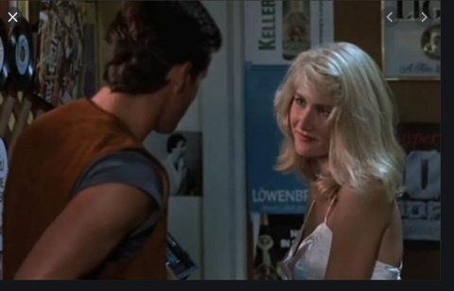
Falling action
Connie is fed up with her mother for nagging her
Her mother feels that Connie is irresponsible unlike her elder sister.
She feels that her mother s being over protective.
Connie falls in love with Ellie and goes out to a restaurant with him
Arnold sees Connie and falls in love with her.

Slide 5
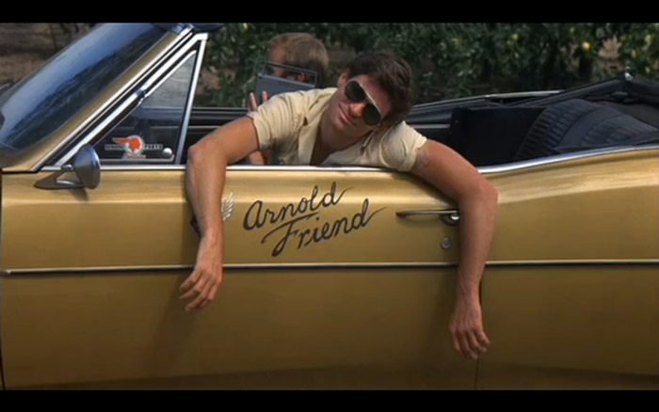
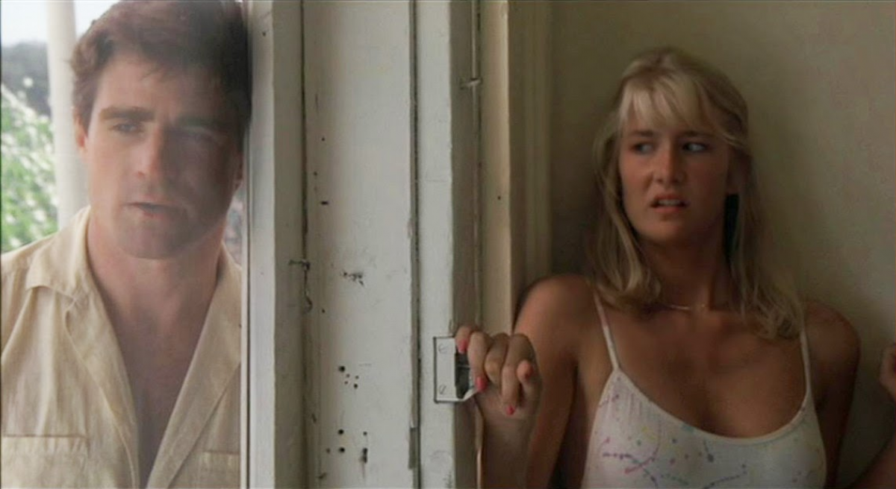
Climax
Connie’s parents and her elder sister go to a family barbeque
Connie is left lonely at home.
Arnold visits Connie at her home to take her out
Connie refuses her request to go out with him as she does not know him
Arnold threatens her
Connie goes for the phone to call the police

Slide 6

Resolution
Her mother comes before she makes the call and Arnold stabs her
Connie is threatened and does not make the call
Arnold leaves and tells Connie where she will find her.
Connie fears for what would happen to her other family members.

Slide 7

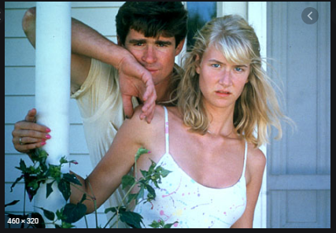
Falling action
Connie's mother is left for dead
Connie's could be forced to end up with her psycho admirer.

